Slide 1
Business meetings

Slide 2
Points to discuss
Group formation process.
Meetings, type, methods and procedures to solve problems.
Elements of effective meetings
Planning- Format, agenda, announcement, procedures of meetings, evaluation.
4. Chair`s and members` roles and tasks
5. Minutes of the meeting.

Slide 3
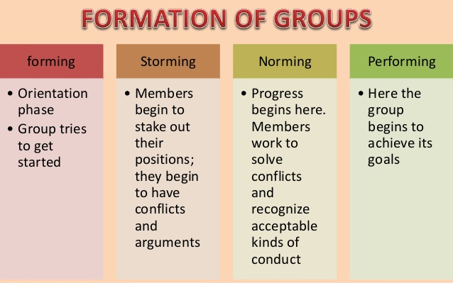

Slide 4
Meeting, Definition:
A scheduled gathering of group members for a structured discussion guided by a designated chairperson. Here they share their knowledge, experience, views and suggestions.
Meetings have many kinds but all share some common features:
Definite purpose (present information, solve problems)
Interaction between people present
Certain rules are followed
An individual controlling the proceedings.

Slide 5
Types of group meetings:
Two general types:
1: Informal:
Unplanned, and spontaneous. Free flowing meetings or get to gathers for social purpose which may latter develop into formal meetings.
2. Formal:
These are structured, task oriented, often search for solution to problems, look for a course of action, to make recommendations to a higher authority, and change policy etc.

Slide 6
TYPES Based on Purpose:
Major objectives of presenting information and solving problems are achieved by TREE TYPES of meetings.
Informational meetings:
Seek to clarify, questions, learn and develop understanding only, get information. i.e. changes in policy, announcement of new mission statement etc.
2. Suggested solution meetings :
These meetings occur to evaluate the suggested solutions/recommendations, explore options to solve a problem.
3. Problem Solving Meetings: (process: problem➔ solution➔ Benefits➔ Action)
Groups try several attempts to find a solution.
The course to reach a solution is unique to every group

Slide 7
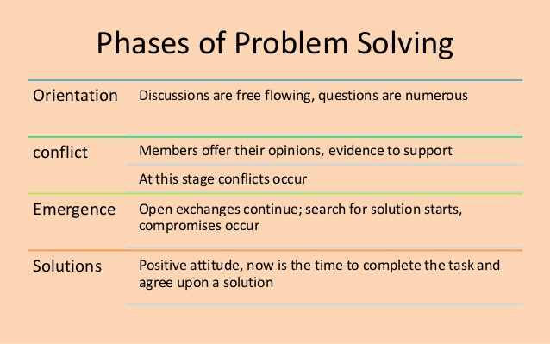

Slide 8
AUTHORIZATION FOR COMMITTEE as strategies to be used for problem solving meetings.
Demand:
Careful planning and supervision from the leader
Rational discussions by participants.
An authorization letter comes from an authorized person who asks you to form a committee to solve a problem.
The letter should include who, what, when, where and why.
Review the Sample AUTHORIZATION letter on pages 181 and 182.

Slide 9
Prompt:
What kind of strategies/Methods you generally use to solve problems in a meeting?
Approaches;
Intuition (rapid inside into the problem)
Rationalization (Justification of solutions over time)
Scientific or reflective thinking (logical progression towards a solution). Most of the times, this approach is used in business meetings.

Slide 10
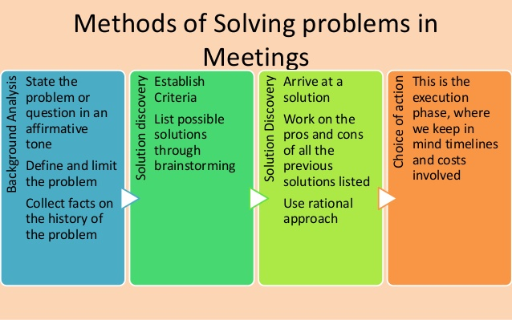
1
2
3
4

Slide 11
Four STEPS of Solving problems through Scientific or reflective thinking
Background analysis.
State the problem or question in an affirmative tone i.e. what should be our procedure in dismissing personnel from their position?
Define and limit the problem. Questions need definition i.e. By personnel we mean only those employees …
Collect facts on the history of the problem. Ask several questions about the problem. How, what when, can we? How others?
Background information pays way for solution discovery.

Slide 12
Four steps of Solving problems through Scientific or reflective thinking
2. Solution discovery: (establishing tentative solutions on a problem)
Establish Criteria i.e. solutions should hold: Fairness, workability, acceptability, positive, maximum returns, favorable cost, adequate etc.
List possible solutions through brainstorming. No criticism on any idea posed.
I.e. what should be the policy for drugs in workplace?
Consent forms during requirement.
convey messages in written and spoken.
Drug rehabilitation programs.

Slide 13
Four steps of Solving problems through Scientific or reflective thinking
3. Solution Analysis
Evaluate all suggestions in the light of criteria.
Work on the pros and cons of all the solutions listed.
Use rational approach- whether the solution will work or not?
Using this, you may reach to tentative solutions, new solution, or combined parts of several solutions.
Arriving to a solution is vital in this phase.
As questions: What will be the consequence in future/on others? Dangers? Ne problems? Will all causes be removed? Criteria?

Slide 14
Four steps of Solving problems through Scientific or reflective thinking
4. Choice of Action
This is the execution phase. We keep in mind timelines and costs involved. Action is taken if it meets criteria, cost, time schedule etc.

Slide 15
Elements of Good Meetings
Planning and preparation
Decide on Format (Face to face, Electronic, or Combination)
Determine purpose (to determine, decide, ask) and crate
Agenda
d) Announcement-what, where, when, why)
e) Logistical/physical arrangements and its rechecking
2. Minutes of the meeting
3. Effective follow-ups and feedback
Responsibilities of chairperson/authority.
In good meetings, people nod in agreement;
in poor meetings, people just nod.

Slide 16
Chairperson’s Tasks
Pre-Meeting | During the Meeting | Post-Meeting
Plan the meeting Notify members Distribute materials Remind members Prepare for discussion | Begin on time Delegate minutes Follow the agenda Facilitate the discussion Provide closure | Evaluate the meeting Distribute the minutes Monitor assigned tasks Follow ups

Slide 17
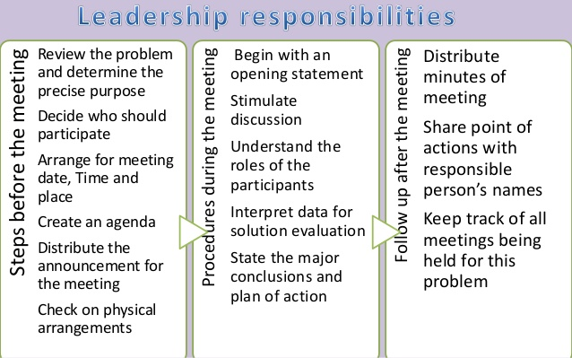

Slide 18
Planning.
Meetings can go wrong in many ways. For example, they may deal with trivial issues, or fail to deal with a major issue for many reasons. They can be irrelevant, unfocussed, badly chaired, boring, long, digressed, and fail to reach conclusions.
Careful preparation can solve these problems. For that, consider the following.
what is the purpose?
Who should attend the meeting?
When and where will the meeting be held?
What information should participants receive in advance?
What will be your role in the meeting?
Who will be affected by the outcome and so needs to be consulted?
Who can supply any relevant information?
Who can play a vital role in taking any follow-up action?
Decide when and where of the meeting?

Slide 19
efficiently conducting the meeting (Roles of chairperson).
For an effective leader, knowing three kinds of leadership before, during and after the meeting.
AUTHORITARIAN | Shows contempt for and praises who agree, dominant, loud, orders and commands, defends one`s self.
LEADERLESS | Delegates directions and decision making steps to others. Shares leadership, allows high ability people to run the meeting. Its rarely beneficial. Team lacks positive motivation.
DEMOCRATIC/ PARTICIPATIVE | Group has final authority. Leader helps group make best decision, invites minority opinions, evaluates unsupported generalizations, clarifies vague statements, allows others to conclude, & facilitates productive discussion .

Slide 20
Planning: determine purpose and create Agendas
Putting the problem into three kinds of questions is vital to develop purpose and the agenda.
Question of Fact (trying to change our opinion/view of a issue)
I.e. What are the constraints on advertising?
2. Question of Value (trying to show the rightness or wrongness of an issue)
i.e. What`s the benefit, is it worthwhile, any value?
3. Question of Policy (trying to change our behavior)
What should? who should? what action? Would it be fair?

Slide 21
Agenda
The outline/list/schedule/calendar of items to be discussed and tasks to be accomplished during a meeting. is an organizational and time management tool. It helps members to prepare for the meeting.
Sample Purpose to be included in agenda:
to identify the school's parking problems and their causes as the first step to improving parking.

Slide 22
The Agenda: Major elements
Call to order and Call to Roll
Review and approval of agenda (Purpose)
3. Reading of previous meetings` minutes
Business arising from minutes
Treasurer’s report
6. Correspondence
7. Reports from committees
8. New business
9. Date and time for next meeting
10. Adjournment

Slide 23
Agenda: other elements to remember
Date, Time, and Place
Provide time markers for each separate item.
Anticipate more controversial topics
Identify lead person for each topic
Individual and Committee Reports
Unfinished and New Business
Announcements
Adjournment

Slide 24
agenda Sample 1.
Executive Committee Agenda for the meeting on – Apr. 20, 2019, to be held at EE Auditorium
7:30 PM Call to Order(“I call this meeting to order.”) & Roll call (leader) Mr. A
7:35 Action on Minutes of April. 05, 2019 Ex.Com Meeting Miss. A
7:40 Status of 2018 Audit and IRS Form 990 Tax Return  Mr. C
7:55 Latest on Third Play and Inter-District Registration Mr. B
8:10 Establishing E-Donation Capability (action desired) Mr. A
8:20 Soliciting Donations to MAR at Events (review process only) Mr. A
8:45 Major Topics for March 19 Board Meeting Mr. A /All
8:55 Adjourn to Executive Session for Personnel Discussion Mr. A
9:00 Targeted Adjournment
Note:  Indicates separate document for this item

Slide 25
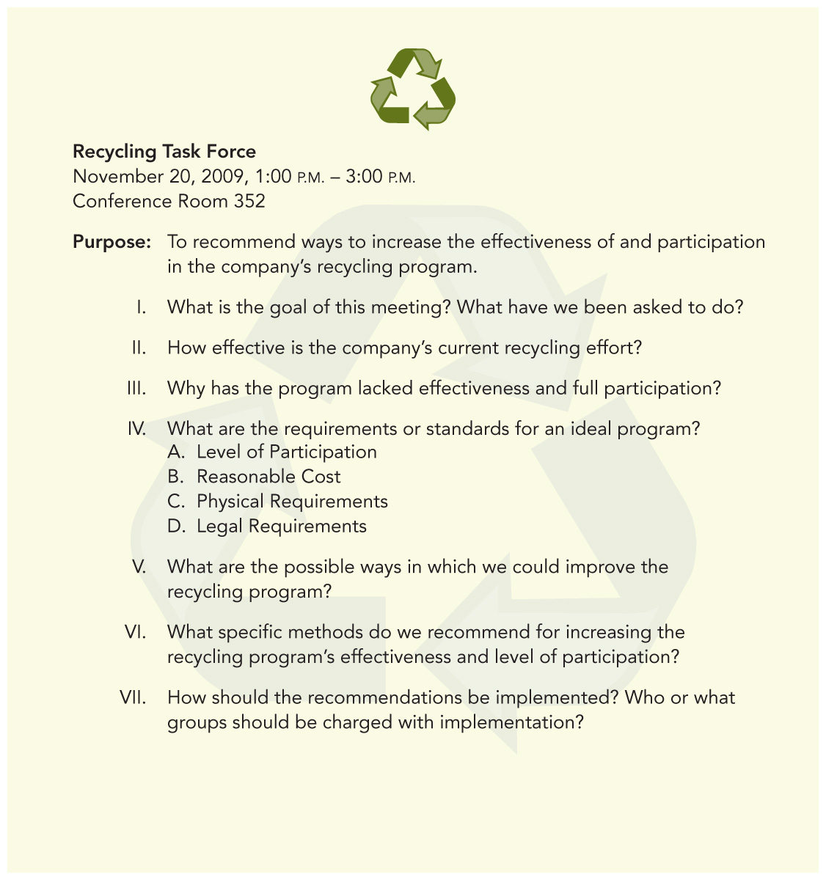
Sample 2. Discussion Agenda

Slide 26
Announcement and Logistics.
After deciding on purpose, main questions and roles, creating agenda, deciding on who, what where, when and why, send it.
Logistics:
Parking, Venue, seating arrangement, number of seats, refreshments, other physical requirements,

Slide 27
Procedures during the meetings.
Start with a neutral and an unbiased statement: problem, importance of problem, quotation, purpose (p-272)
Stimulate discussion-involve all.
Understand the roles of participants as individuals as well as groups.(page 273-74)
Interpret data for solution evaluation- evaluate suggestions, discuss pros and cons, avoid imposing opinions, give role of leadership to others if possible.
State the major conclusion and plan of action- Summarize and make sure all know their responsibilities. End with a clear call for an action.

Slide 28
Meeting minutes
The minutes of a meeting are . . .
the written record of a group’s discussion, activities, decisions & actions.
legal documents as well as historical records of organization business.
a way to share what happens with members who don’t attend.
a way to prevent disagreement over assignments and group decisions.

Slide 29
What to Include in the Minutes
Group`s, absent members`, and chair`s names.
Time, date, place, the exact wording of motions, naming mover and seconder.
Time the meeting was called to order and adjourned
Name of person preparing the minutes
Summary of discussion and decisions including action items

Slide 30
Taking Minutes
Write clear statements that summarize the meeting’s main ideas and actions.
If in doubt, ask the group for clarification.
Attach the agenda and any reports to the final copy of the minutes.
Report the facts, decisions, motions, action items, deadlines and all sides of a discussion accurately as the group makes them.
Always keep in mind that the minutes are a public record of the meeting.

Slide 31
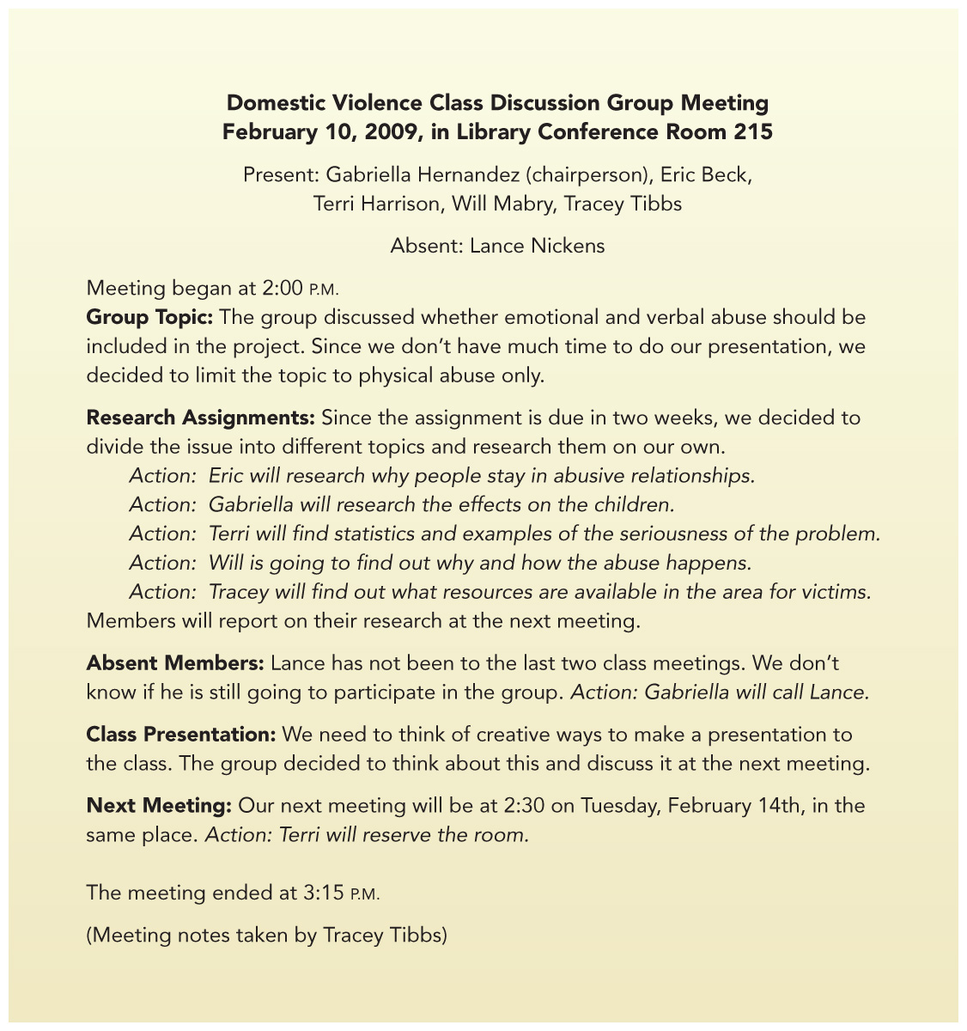
Sample of Informal Minutes

Slide 32
MINUTES OF THE [INSERT NAME] BOARD OF DIRECTORS
Monday, June 28, 2020
ABC Salon Rose Board room
1 rue des Carrières, Québec City, Québec G1R 4P5
8:30 a.m. – 2:00 p.m. (8:00 a.m. In-Camera Session)
CONTINUES

Slide 33
SAMPLE FORMAT FOR MEETING MINUTES. CONTINUES.

Slide 35
MORE SAMPLES
Nominations & Governance Committee Meeting
June 9, 2011, at 1 p.m. EST
By teleconference [Insert Dial in information and participant code]
PRESENT:
B. Brown, Chair, R. Bradley, J. T. Franks, S. Steal
STAFF:
M. Pound - Chief Executive Officer
P. Robb – Executive Assistant, Recorder
REGRETS:
E. F. Bradson, Jr.
The meeting was convened at 1 p.m.
4. Approval of Agenda
MOTION #01N-06-11
To accept the agenda of June 9, 2011, as presented.
Moved: J.T. Franks Seconded: S. Steal
CARRIED
5. Approval of Minutes
MOTION #02N-06-11
To approve the Minutes of March 28, 2011
Moved: J.T. Franks Seconded: S. Steal
CARRIED
6. Committee Membership
S. Steal agreed to sit on the Audit Committee until the full complement of members is appointed to the
Board. At that time this item will be brought to the Chair of the Audit Committee in order that it is dealt
with quickly.

Slide 36
7. Board Vacancy
It was noted that Mr. Bradson’s last term will end on June 20, 2011. He is to be recognized at the Board
dinner on June 13 and presented with a bronze statue.
The Committee reviewed the list of interested candidates for the Board vacancy. Discussion ensued.
Interviews will be scheduled as soon as possible with the intent to appoint a board member by the
meeting in the fall.
ACTION
To proceed with scheduling back-to-back interviews with the successful candidates and notify those who
were unsuccessful. (P. Robb).
Other Business
No further items were brought forward for discussion.
Adjournment
There being no further business, the meeting was adjourned at 1:36 p.m.
MINUTES APPROVED BY:
_________________________
B. Brown, Chair

Slide 37
Follow up and Post-Meeting Evaluation
It`s leader`s responsibility to send the minutes to all members and keep it`s physical record.
EVALUTION
Have objectives achieved?
Was the meeting’s goal clear?
Was the agenda useful and followed?
How prepared were group members?
Did everyone have an equal chance to participate?
Did members listen effectively and consider different points of view?
Were assignments and deadlines made clear by the end of the meeting?

Slide 38
Task: Additional Evaluation Questions
What other evaluation questions would you add?
Example: Did the meeting begin and end on time?
Example: ________________________
Example: ________________________
Example: ________________________

Slide 39
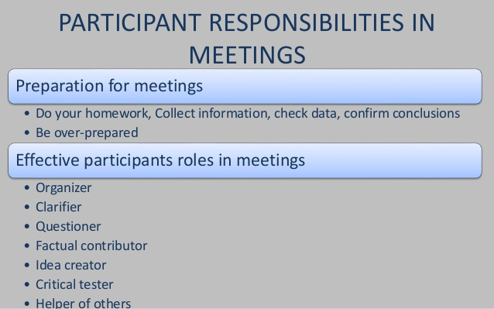

Slide 40
Responsibilities of the EFFECTIVE Participants
TASK:
REVIEW THE RESPONSIBILITIES OF THE EFFECTIVE PARTICIPANTS, IN DETAIL, GIVEN ON PAGES 275-279.
Organizer, Clarifier, questioner, factual contributor, Energizer, idea creator, critical tester, Conciliator, helper of others.

Slide 41
Giving effective feedbacks

